Slide 1


ISO/IEC Directives Part 1
IEC Directives Supplement
Changes introduced in 2022
IEC Central Office
Standardization Division
2022-05-06
International
Electrotechnical
Commission

Slide 2
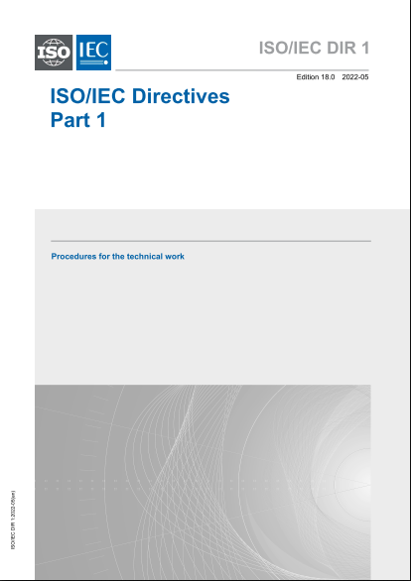
Changes in the Directives Part 1

Slide 3
Summary of the main changes
  Abstention is fully considered as a National Committee vote
  Working Group meetings: documents on the CP and introduction of hybrid meetings
  Joint working groups operations: improved balance between the committees
  Membership of advisory and ad-hoc groups: clarification of Members roles
  Liaison between ISO and IEC Committees: Liaison representatives can attend WG meetings
  Committee Stage, clarification of the process
  Decisions at enquiry stage: Clarification of the options to move forward, second CDV now possible in case of approved CDV
  Conversion of a CDV into a TS or PAS: directly to DTR or DPAS
  TS PAS and TR: Major review of the text to include the purpose of each publication and add a second optional DTS TPAS, DTR ballot for technical changes
  Consistency of terminology: Use of the term "document" throughout Directives in replacement of “publication” or “deliverable”
3

Slide 4
Participation in the work of Committees
About voting and abstention in Clause 1.7.3
  National Committees can voluntarily downgrade to O-membership if they lack expertise.
1.7.3 A National Body may, at any time, begin or end membership or change its membership status in any technical cCommittee or subcommittee in IEC by informing the office of the CEO and the secretariat of the Ccommittee concerned, and in ISO by direct input via the Global Directory, subject to the requirements of clauses 1.7.4 and 1.7.5.
Furthermore, a P-member may voluntarily downgrade to O-member if it consistently lacks expertise for votes at the Committee level or to participate in working groups.
4

Slide 5
Working Groups
About Working Groups operation in Clause 1.12
  When a Convenor resigns, a call for candidates is required in the committee
  The use of the Collaboration Platform is required to circulate WG documents
1.12.1 … Responsibility for any changes of convenors rests with the committee and not with the National Body (or liaison organization). In a case a WG convenor resigns, the Secretary shall launch a call to identify new candidates.
1.12.6 Working groups should use current electronic means to carry out their work wherever possible. For transparency and traceability, the electronic platform provided by the Office of the CEO shall be used for circulation of WG documents and communication with members.
5

Slide 6
Working Group meetings
Hybrid Working Group meetings in Clause 4.2.2.1
  Uniform use of the terms “virtual”, “Hybrid” and “face-to-face”
  Hybrid meetings added, they follow the rules for face-to-face meetings
4.2.2 Working Group meetings
4.2.2.1 Working groups shall use current electronic means to carry out their work (for example, e-mail, groupware and teleconferencing) wherever possible. A working group may meet in either virtual, hybrid or face-to-face mode. For a fully remote virtual meeting, the advance notice shall be made available a minimum of 4 weeks in advance of the meeting.
When a physical face-to-face or hybrid meeting needs to be held, notification by the convenor of the meetings of a working group shall be sent to its members and to the secretariat of the parent committee, at least 6 weeks in advance of the meeting.
The Working Group leadership should ensure that everything reasonable is done to enable Experts to actively participate.
Arrangements for meetings shall be made between the Convenor and the member of the working group in whose country the meeting is to be held. The latter member shall be responsible for all practical working arrangements.
6

Slide 7
Liaison between ISO and IEC
About the role of the liaison representative in Clause 1.16.2
  Clarification that the Liaison Representative can attend working group meetings
1.16.2 Liaison Representatives designated by ISO or IEC shall have the right to participate in the discussions of the other organization's technical committee or subcommittee whose work they have been designated to follow and may submit written comments; they shall not have the right to vote.
They may also attend meetings of working groups of the technical committee or subcommittee, but only to contribute the viewpoint of their own technical committee on matters within its competence.
7

Slide 8
Joint Working Groups
About Joint Working Groups operation in Clause 1.12.7
  The changes introduced intend to provide a more balanced operation of JWGs between the “leading” committee and the other joined committees
  Change all terms “administrative lead” to “administrative responsibility”
  The administrative responsibility is defined at the project level
  (in the same JWG with several projects, the administrative responsibility can be assigned to different committees)
  Several co-convenors possible up to one per committee in the JWG
  Major Changes in the JWG project are decided by all the committees involved
  Clarification: JWGs can develop any documents (IS, TS, TR, PAS)
  Clarification: IEC/IEC JWG’s one NP ballot in the TC having the administrative responsibility
  Clarification: ISO/IEC JWG’s two NP ballots to be done, one in IEC and one in ISO
8

Slide 9
Joint Working Groups
1.12.7 In special cases a joint working group (JWG) may be established to undertake a specific task in which more than one ISO and/or IEC Committee is interested. The task can include the development of any deliverable. Committees who receive requests to establish JWG shall reply to such requests in a timely manner.
[…]
The decision to establish a joint working group shall be accompanied by mutual agreement between the Committees on:
— the Committee/organization having the administrative responsibility for the project for the JWG or for project(s) assigned to the JWG;
— each committee participating in the JWG may appoint an individual to serve as a co-convenor or the involved committees may decide to have one convenor. The appointed (co-)convenor(s) shall seek consensus from all experts involved to organize the work and schedule meetings;
[…]
Subsequent major changes to a jointly developed project such as the change of scope, deliverable, etc. shall be decided by all Committees involved in the JWG.
9

Slide 10
Joint Working Groups
1.12.7
[…]
For proposal stage (NP)
For ISO/ISO, or IEC/IEC JWGs only one NP ballot is needed. For JWGs where all involved committees are administered by the same organization there shall be only one NP ballot. If a NP has already been launched or approved in one committee, it cannot be balloted again in another committee. For ISO/IEC JWGs two NPs are launched, one in each organization.
For JWGs where the involved committees are administered by different organizations, there shall be an NP ballot in each organization.
[…]
10

Slide 11
Joint Working Groups
1.12.7
[…]
For Committee stage (CD)
— The CD is circulated for review and comment by each Committee.
After the CD ballot, the (co-)convenor(s) and the JWG shall address all the input received.
— The final CD requires consensus by all Committees, as defined in the ISO/IEC Directives, Part 1.
For enquiry and approval ballots
— National Bodies are requested to consult all national mirror Committees involved to define one position. A statement is included on the cover page to draw attention of National Bodies.
— For an ISO/IEC JWG, two enquiry/approval ballots are launched, i.e. one in each organization.
— After the enquiry ballot, the (co-)convenor(s) and the JWG shall address all the input received.
The Foreword identifies all Committees involved in the development of the deliverable.
For JWGs administered separately by ISO and IEC, two DTS/DPAS/DTR ballots are launched, i.e.: one in each organization.
11

Slide 12
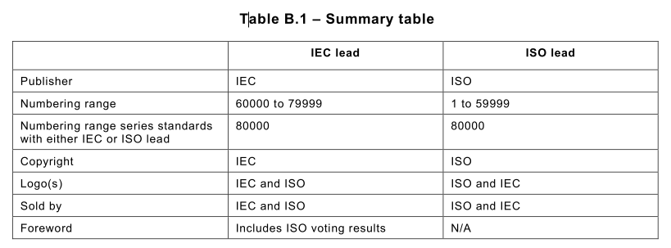
ISO/IEC joint projects
Summary table added in Clause B.4.2.9
  Related to joint developments under “Mode 5”
  The summary table do not bring any further changes, it only intends to provide the information more clearly
12

Slide 13
Advisory groups
About AGs type of membership in Clause 1.13.2
  More open membership: change from “shall be” to “may include”
  Clarification of the type of membership: members acting as individual experts or representative of their country
  Clarification that the convenor and type of membership is a committee decision
1.13.2 A proposal to establish such a group shall include recommendations regarding its constitution and terms of reference, including criteria for membership, bearing in mind the requirement for sufficient representation of affected interests while at the same time limiting its size as far as possible in order to ensure its efficient operation. Members of advisory groups shall be Committee officers, individuals nominated by National Bodies and/or, as relevant, by A-liaison organizations. Members of advisory groups may include Committee officers, individuals nominated by National Bodies (either individuals representing their own expert opinion or individuals representing the interests of their National Body and representatives of liaison organizations. The parent committee shall approve the appointment of the convenor, final constitution type of membership and the terms of reference prior to the establishment of any nominations to of the advisory group and nominations to it.
13

Slide 14
Ad hoc groups
About ad hoc groups operation in Clause 1.14
  The concept of ad hoc groups is extended to topics outside the strict context of a plenary meeting
  More open membership: change from “shall be” to “may include”
  Clarification of the type of membership: members acting as individual experts or representative of their country
  Clarification that the convenor and type of membership is a committee decision
  Ad hoc groups would be disbanded when their work is completed
14

Slide 15
Ad hoc groups
1.14 Ad hoc groups
Committees may establish ad hoc groups, the purpose of which is to study a precisely defined problem on which the group reports to its parent committee at the same meeting, or at the latest at the next meeting.
The membership of an ad hoc group shall be chosen from the delegates present at the meeting of the parent committee, supplemented, if necessary, by experts appointed by the Committee. Members of ad hoc groups may include Committee officers, individuals nominated by National Bodies (as appropriate, either individuals representing their own expert opinion or individuals representing the interests of their National Body) and representatives of liaison organizations. The committee shall approve the appointment of the convenor, type of membership, terms of reference and target date for completion of the work prior to the establishment of the ad hoc group and nominations to it. The membership of an ad hoc group shall be chosen from the participants present at the meeting of parent committee, supplemented, if necessary, by experts appointed by the committee. The parent committee shall also appoint a convenor.
An ad hoc group The committee shall disband the ad hoc group be automatically disbanded at the meeting to which when it has presented its report. completed its work.
15

Slide 16
Preparatory stage (Clause 2.4)
About the Project Leader reporting line in Clause 2.4.5
  Clarifies the reporting line of the project leader
2.4.5 The project leader is responsible for the development of the project and will normally convene and chair any meetings of the working group related to the project. For projects registered directly under the committee, the project leader reports to the committee officers. For projects registered under a WG, the project leader reports to the convenor of the WG. Work continues until consensus is reached on the proposed text. The project leader may invite a member of the working group to act as its secretary.
16

Slide 17
Committee Stage - Chairs responsibilities
About Chair responsibilities for the decision after CD ballot in Clause 1.8.2
  Clarify the type of meetings conducted bay the Chair (plenary meetings and not WG meetings)
  Clarify that the Chair makes the decision following the CD ballot
1.8.2 Responsibilities
[…]
c) conduct Committee meetings with a view to reaching agreement on committee drafts (see 2.5);
[…]
f) take appropriate decisions at the committee stage (see 2.5) and enquiry stage (see 2.6);
17

Slide 18
Committee Stage
To clarify the process for CD stage in Clause 2.5.3
  The term “appropriate group” was introduced to accommodate JTC 1 which sometimes establish ad hoc groups to address comments
  Adding the term “revised committee draft” for clarification purpose
2.5.3
[…]
a) to discuss the committee draft and comments at the next meeting of the appropriate group, which would typically be the working group to which the project is assigned, as determined by the committee for this purpose, or
b) to circulate a revised committee draft for consideration, or
c) to register the committee draft or revised committee draft for the enquiry stage (see 2.6). In the case of Technical Specification, Publicly Available Specification or Technical Report there is no enquiry stage (See 3.1.1, 3.2.1 and 3.3.1 for the approval and publication).
18

Slide 19
Committee Stage
To clarify the process for CD stage in Clause 2.5.5
  Clarification that the responsibility for the consensus evaluation is to the Chair (questions received about who was judging that consensus was obtained)
  Text added to highlight that WG meetings after the circulation of the CD should focus on comments resolution
2.5.5 Consideration of successive committee drafts shall continue until consensus of the P-members of the Committee as judged by the Chair has been obtained or a decision to abandon or defer the project has been made.
Consideration of successive committee drafts should be focused on resolving the comments raised by National Bodies and liaison organizations for the purpose of achieving consensus of the P-members of the Committee (see 2.5.2).
19

Slide 20
Committee Stage
To clarify the process for CD stage in Clause 2.5.6
  Clarification that the decision to go for CDV circulation is to the Chair
  Clarification of the process in case of doubt about consensus by adding the reference to the “revised” CD modified to address the comments
2.5.6 The decision to circulate an enquiry draft (see 2.6.1) shall be taken by the Chair of the Committee on the basis of the consensus principle among the P-members.
[…]
In case of doubt concerning consensus on a revised committee draft, approval by a two-thirds majority of the P‑members of the committee voting may be deemed to be sufficient for the revised committee draft to be accepted for registration as an enquiry draft; however every attempt shall be made to resolve negative votes.
20

Slide 21
Enquiry stage
To clarify the process for CDV stage and add a second CDV ballot in Clause 2.6.4
  Introduction of “appropriate group” like for the CD stage
  Optional second CDV ballot on an approved CDV
  For rejected CDVs, the second ballot is shortened to 8 weeks
  Clarification of the initiation stage for TS and PAS when a rejected CDV is converted into a TS or a PAS
  Decision of cancellation of the project for rejected CDVs is to the committee
2.6.4 On receipt of the results of the voting and any comments, an appropriate group of the committee, which would typically be the working group to which the project is assigned, will at a meeting address any comments received and prepare as needed a revised version. The group will advise the Chair on the possible courses of action. The Chair of the committee, in cooperation with its secretariat and the Project Leader or working group Convenor, and in consultation with the office of the CEO, shall take one of the following courses of action:
[…]
21

Slide 22
Enquiry stage
2.6.4
[…]
b) when the approval criteria of 2.6.3 are met, but technical changes are to be included:
to register the revised enquiry draft, as modified, as a final draft international standard, or
to circulate the revised enquiry draft for voting (see 2.6.1). The revised enquiry draft will be circulated for a voting period of 8 weeks. Committees are limited to only one revised enquiry draft where the approval criteria are met in this case.
[…]
c) when the approval criteria of 2.6.3 are not met:
1) to circulate a revised enquiry draft for 8 weeks voting (see 2.6.1), or
2) to circulate a revised committee draft for comments, or
3) to circulate a revised draft as a DTS or DPAS, or
4) To cancel the project, subject to decision by the committee
NOTE In case 3), the project shall start at the approval stage (i.e.: DTS or DPAS).
22

Slide 23
Corrections and amendments
To clarify the process for amendments in Clause 2.10.3
  Clarify the use of multiple concurrent amendments.
  The current process already allows for a 2nd amendment.
  The first amendment changes the content of the previous edition and the second amendment changes the content of the previous edition amended by the first amendment.
2.10.3 Amendments
An amendment alters and/or adds to previously agreed technical provisions in an existing International Standard and its prior amendment if any. An amendment is considered as a partial revision: the rest of the International Standard is not open for comments.
[…]
23

Slide 24
Development of other deliverables (TS, TR, PAS)
The Clause 3 Development of other documents has undergone important changes to bring improved clarity and harmonization between the three subclauses 3.1 TSs, 3.2 PASs, and 3.3 TRs.
  The Clauses 3.1.1, 3.2.1 and 3.3.1 include text describing the purpose of TSs, PASs and TRs and clarify when such types of publications need to be used
  The Clauses 3.1.2, 3.2.2 and 3.3.2 include text describing the development process for the TSs, PASs and TRs
  If technical changes are required following approved DTS, DPAS or DTR ballots, a subsequent ballot is introduced a subsequent ballot shall be required to approve the revised draft
  A PAS project can be initiated by a committee decision or by an NP ballot (alignment with ISO)
  A TR project can be initiated by a committee decision the term “data of a different kind“ is replaced by “information” for improved flexibility
24

Slide 25
Development of other deliverables
3.1 Technical Specifications
3.1.1 A committee may decide to prepare and publish a Technical Specification when:
the subject in question is still under development, or
The committee has developed a document it wishes to publish as per 2.6.4 and 2.7.7
A Technical Specification may contain normative provisions.
3.1.2 The committee may decide for new projects to follow the procedure set out in 2.3 to initiate the development of a Technical Specification. The required stages for the preparation of a Technical Specification shall be the preparatory stage as set out in 2.4 and the approval stage for publication (8 weeks DTS ballot). Committees may also choose to use an optional committee stage as set out in 2.5. The decision to publish the resulting document as a Technical Specification shall require a two-thirds majority vote of the committee P‑members voting. If technical changes are required following the first ballot, a subsequent ballot shall be required to approve the revised draft.
25

Slide 26
Development of other deliverables
3.2 Publicly Available Specifications
A committee may decide to prepare and publish a Publicly Available Specification when there is an urgent market need and:
There is a need for a preliminary deliverable prior to the development of a full International Standard, or
The committee wishes to adopt a published document from an external organization, which in the IEC may result in a dual logo publication with the external organization, or
The committee has developed a document it wishes to publish as per 2.6.4 and 2.7.7
A Publicly Available Specification may contain normative provisions. A Publicly Available Specification is not allowed to conflict with an existing International Standard. Competing Publicly Available Specifications on the same subject are permitted.
3.2.1 When a Publicly Available Specification is proposed, the Chair may recommend that an optional committee decision by simple majority vote of the committee P members voting is necessary to initiate the process. While a formal NP ballot is not required, the NP form may provide useful information for the committee P-members to consider when deciding to initiate a Publicly Available Specification. In the case of a Publicly Available Specification resulting from 2.6.4 or 2.7.7, the original NP form for the International Standard should provide such information.
The mandatory stage for a Publicly Available Specification is the approval stage for publication (8 weeks DPAS ballot). Committees may also choose to use an optional preparatory stage as set out in 2.4 or an optional committee stage as set out in 2.5. The decision to publish the document as a Publicly Available Specification shall require a simple majority vote of the committee P‑members voting. If changes other than editorial changes are required following the first ballot, a subsequent ballot shall be required to approve the revised draft.
26

Slide 27
Development of other deliverables
3.3 Technical Reports
3.3.1 A committee may decide to publish a Technical Report when it wishes:
to publish information data of a different kind that is not normally published as an International Standard (this may include, for example, information obtained from a survey carried out among the National Bodies, information on work in other international organizations or information on the “state of the art” in relation to standards of National Bodies on a particular subject).
to provide a rationale for specific requirements in a related International Standards.
The document shall be entirely informative in nature containing no requirements, recommendations or permissions and shall not contain matter implying that it is normative. It shall clearly explain its relationship to normative aspects of the subject which are, or will be, dealt with in International Standards related to the subject.
3.3.2 The committee may decide to initiate the development of a Technical Report by simple majority decision of the P-members. The required stages for the preparation of a Technical Report shall be the preparatory stage as set out in 2.4 and the approval stage for publication (8 weeks DTR ballot). Committees may also choose to use an optional committee stage as set out in 2.5. The decision to publish the resulting document as a Technical Report shall require a simple majority vote of the P‑members voting of the committee. If changes other than editorial changes are required following the first ballot, a subsequent ballot shall be required to approve the revised draft. When the P‑members of a committee have agreed upon the publication of a Technical Report, the draft report shall be submitted electronically by the secretariat of the committee to the Office of the CEO within 16 weeks for publication.
27

Slide 28
Editorial changes – New IEC Statutes
New IEC statutes were approved at the 2021 General Meeting which included several terminology changes which have been introduced in the Directives.
  All occurrences of "Council" replaced by "General Assembly"
  All occurrences of "Council Board" replaced by "IEC Board"
  All occurrences of "General Secretary" replaced by "Secretary-General"
  All occurrences of "Central office" replaced by “IEC Secretariat“
28

Slide 29
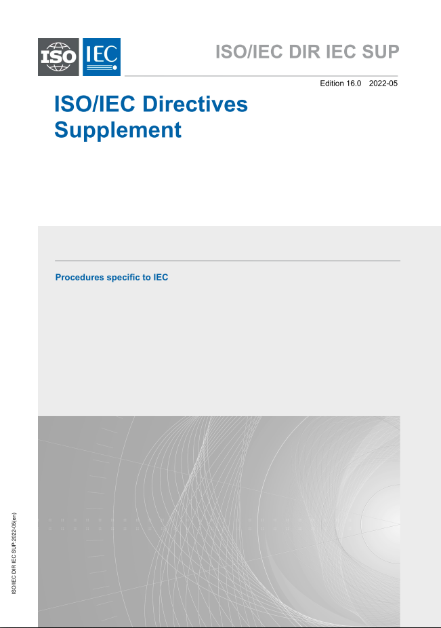
Changes in the Directives Supplement

Slide 30
Summary of the main changes
  Additional Experts after NP ballot closing, clarification that the 4 weeks extra period starts at the NP ballot closing
  Voting statistics for National Committees, clarification that “abstain” is a vote
  Annex SJ has been removed and Annex SI has been updated to cover for Annex SJ
  Note: All subsequent annexes have been renamed i.e., Annex SL becomes Annex SK
  Fully reviewed Annex SK about standards in database format
  Systems Committees secretariat may also be allocated to a National Committee
  Process defined for the maintenance of SRDs
30

Slide 31
Additional Experts after NP ballot closing
Clarification that the 4 weeks extra period starts at the NP ballot closing in
Clause 2.3.5
2.3.5
If the required number of nominated experts has not been obtained by the end of the voting period, P-members having approved the work item and having not yet appointed an expert may, within 4 weeks of the release date of the Voting ReportResult, nominate further experts they consider will contribute effectively to the work, without resubmitting the new work item proposal for ballot.
31

Slide 32
Voting statistics
To clarify the voting statistics calculation in Clause 1.7.4
  Voting "abstain" is considered as a vote and is counted when calculating the P-Members participation statistics
1.7.4
[…]
2a) In IEC:
has failed to vote on questions formally submitted for voting within the Committee (see 1.7.1).
Note: abstentions are taken into account when evaluating P-Member participation
2b) In ISO:
has failed to vote on over 20 % (and at least 2) of the questions formally submitted for voting on the committee internal balloting (CIB) within the Committee over one calendar year (see 1.7.1).
[…]
32

Slide 33
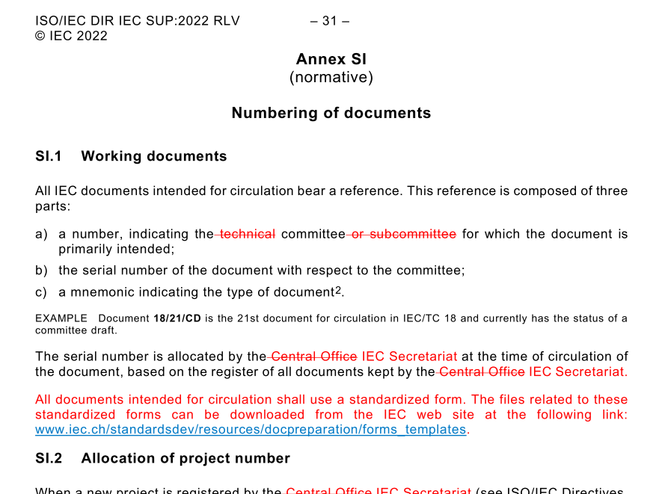
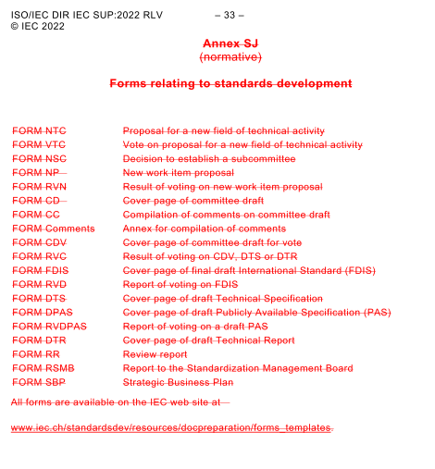
Removal of Annex SJ
Clarification that the 4 weeks extra period starts at the NP ballot closing in
Clause 2.3.5
33

Slide 34
Annex SK - Standards in Database format
Annex SK has undergone a full revision prepared by the IEC Database Reference Group, a group of Experts from various TCs and SCs, and approved by SMB (SMB/7331/R and SMB/7331A/RV)
  Inclusion of procedures on the creation or maintenance of the structure of an SDB and procedures on the creation or maintenance of the content
  SDB owner committee: committee responsible for an SDB (database structure)
  change request (CR): proposal to add, change or withdraw one or more data elements in an SDB. CRs can be made by a committee other than the owner committee
  SDB team: permanent group of experts appointed by and acting as delegates on behalf of their National Bodies to evaluate and validate the change requests
  Processes have been defined for the creation and/maintenance of the structure and the content of standards in database format.
34

Slide 35
Systems Committees secretariat
To allow National Committees undertaking the secretariat of Systems Committees in Clause S0.2.7
  Up to now, the secretariat of Systems Committees was automatically allocated to the IEC Secretariat
  Note: The same applies in the case of a subcommittee of a Systems Committee
SP.2.7 By default, the Secretariat of Systems Committee is allocated to the IEC Secretariat. Once set up and at any time of its existence, a Systems Committee can seek approval from SMB to allocate its secretariat to a National Committee. The allocation of the secretariat in this case shall follow the same procedure as that used for Technical Committees.
35

Slide 36
Maintenance process for SRDs
The Clause SO.7.1 Systems Reference Deliverable updated
  Text has been added to define the process for the maintenance of SRDs.
SO.7.1 Systems Reference Deliverable
A Systems Reference Deliverable (SRD) is a deliverable produced by a SyC, which provides guidance on the use and application of standards in the corresponding SyC’s domain. An SRD can be a normative document which may be referenced in the same way as any other IEC deliverable
The clauses of an SRD can be normative or informative, as may be appropriate.
The development, voting, and approval and maintenance processes for an SRD shall be as defined in ISO/IEC Directives Part 1, 3.1 except 3.1.3 which shall not apply. The decision to initiate a maintenance project for an SRD shall be as defined in 2.9. Once approved, the development process of the maintenance project shall follow the regular SRD process.
In case that the SyC would like to transform an SRD to an IS, it is required to use the process outlined in SO.7.2.
36

Slide 37
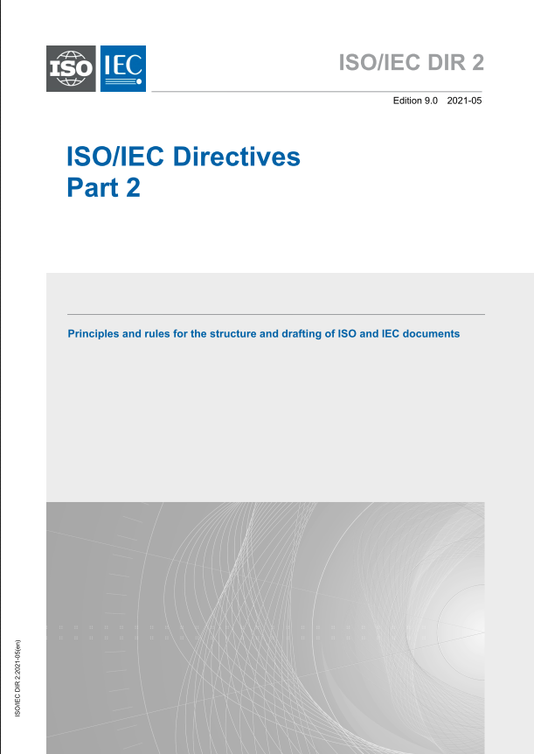
Reminder Directives Part 2
The ISO/IEC Directives Part 2 about the drafting of ISO/IEC documents was reviewed in 2021.
The changes are addressed in a separate presentation.

Slide 38

Thank you!
IEC Central Office
Standardization Division

